Slide 1


Retail Data Analysis using SAS Viya
[Student Name]

Slide 2
Importance of Retail data Analytics
Opportunities
Targeted promotion and Customized Buying Experience/
Growth In Market
By exploiting the Available opportunities in the market
Customer Loyality
Earning Loyalty of Customer by understanding their need

Slide 3
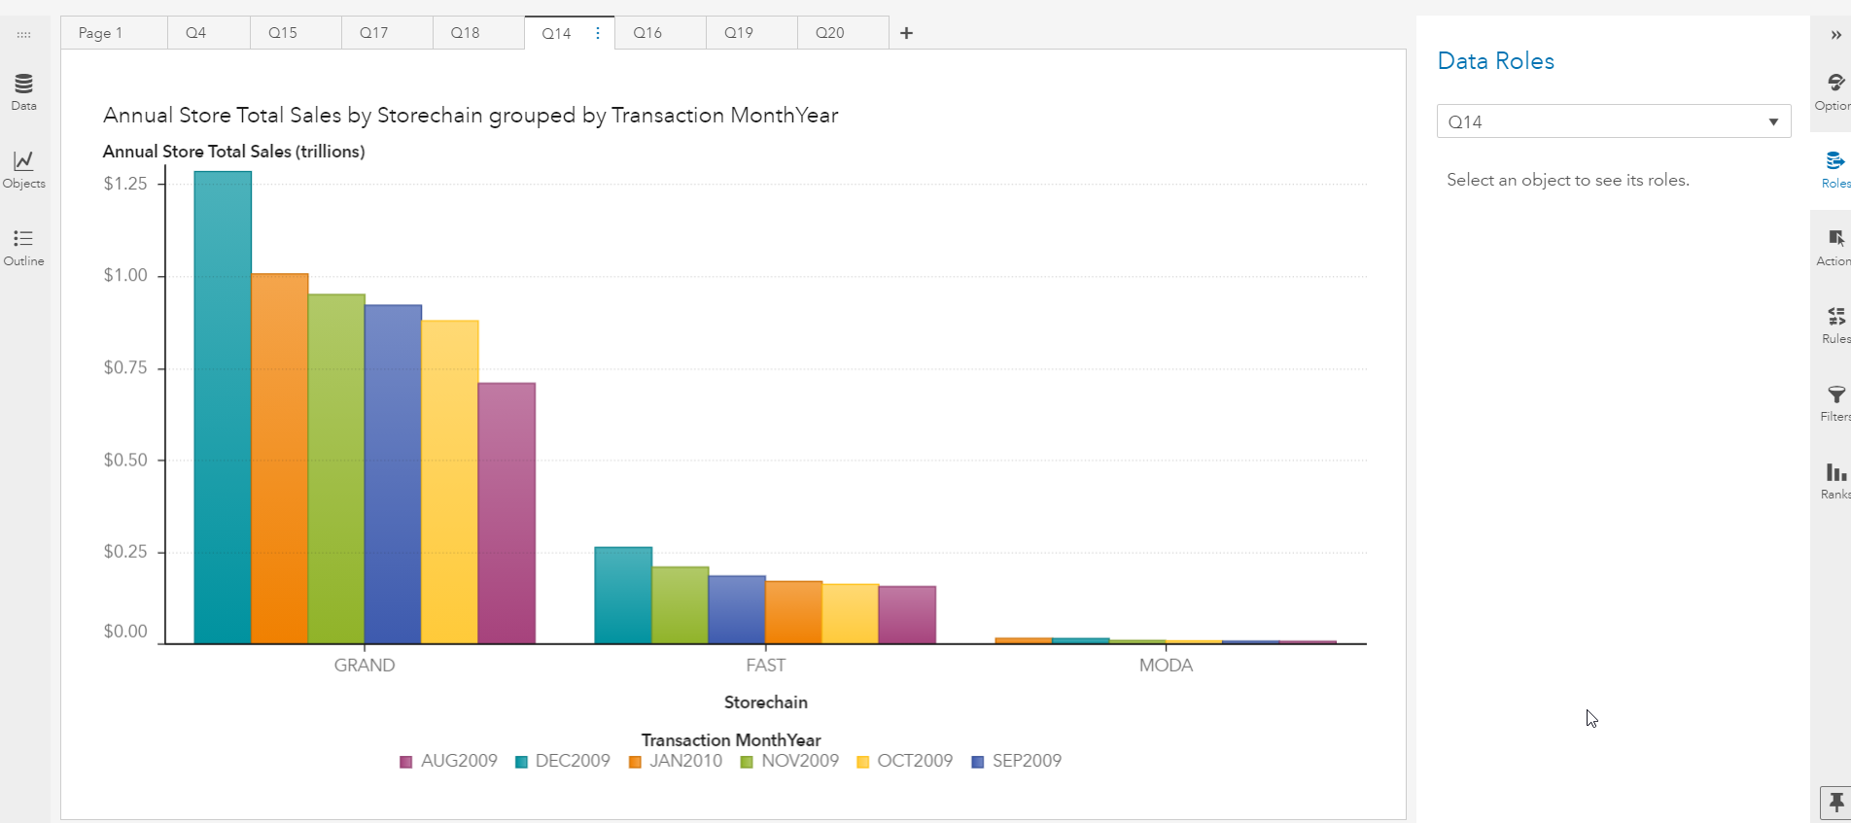
Insights
The annual total sales store chain across countries are depicted at the side.
Most number of transactions are recorded in December month.

Slide 4
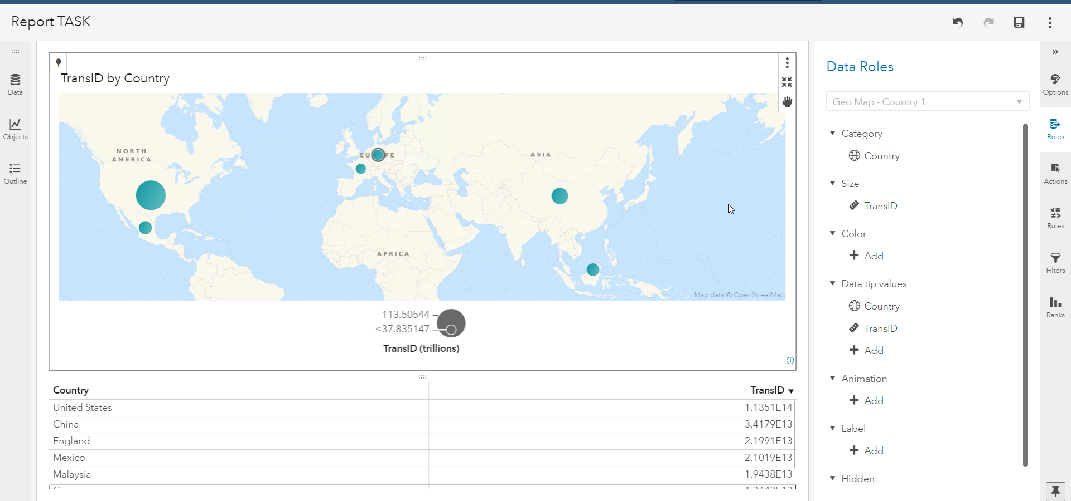
Insights
The geo map is given at the side.
maximum number of sales transactions are recorded in USA.

Slide 5
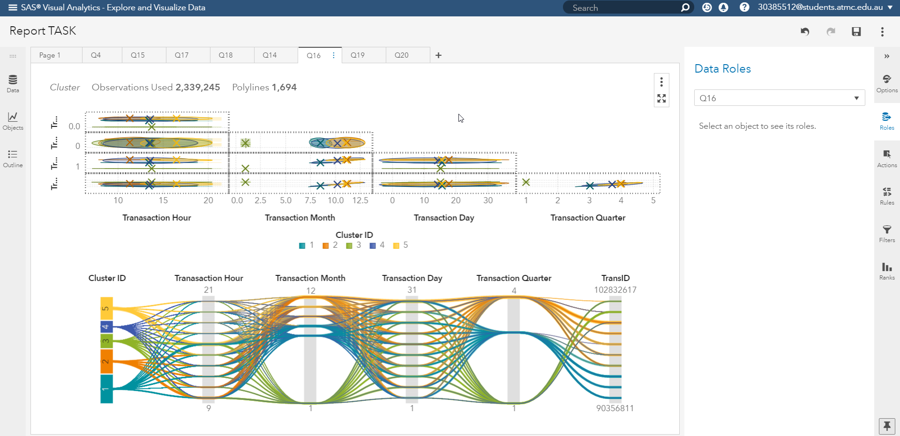
Insights
The plot at the side is cluster plot of all the given transaction data in the file.

Slide 6
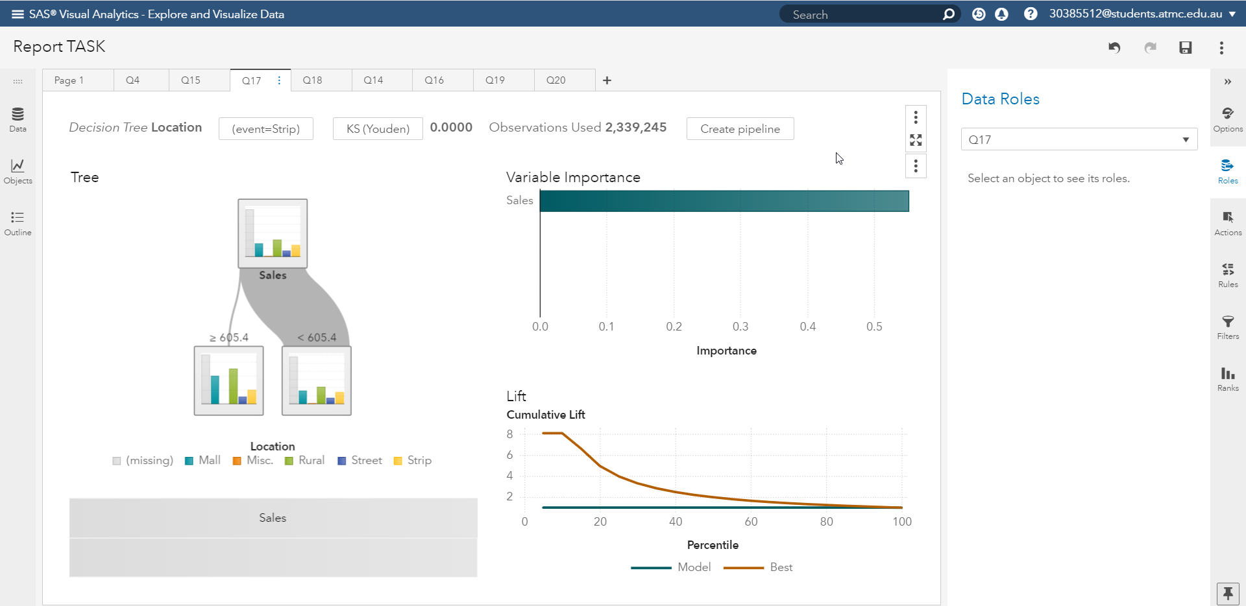
Insights
For the location of sales the Sales amount is the important factor.
If value of sales is >605.4 then most probably the location will be malls or Rural area.

Slide 7
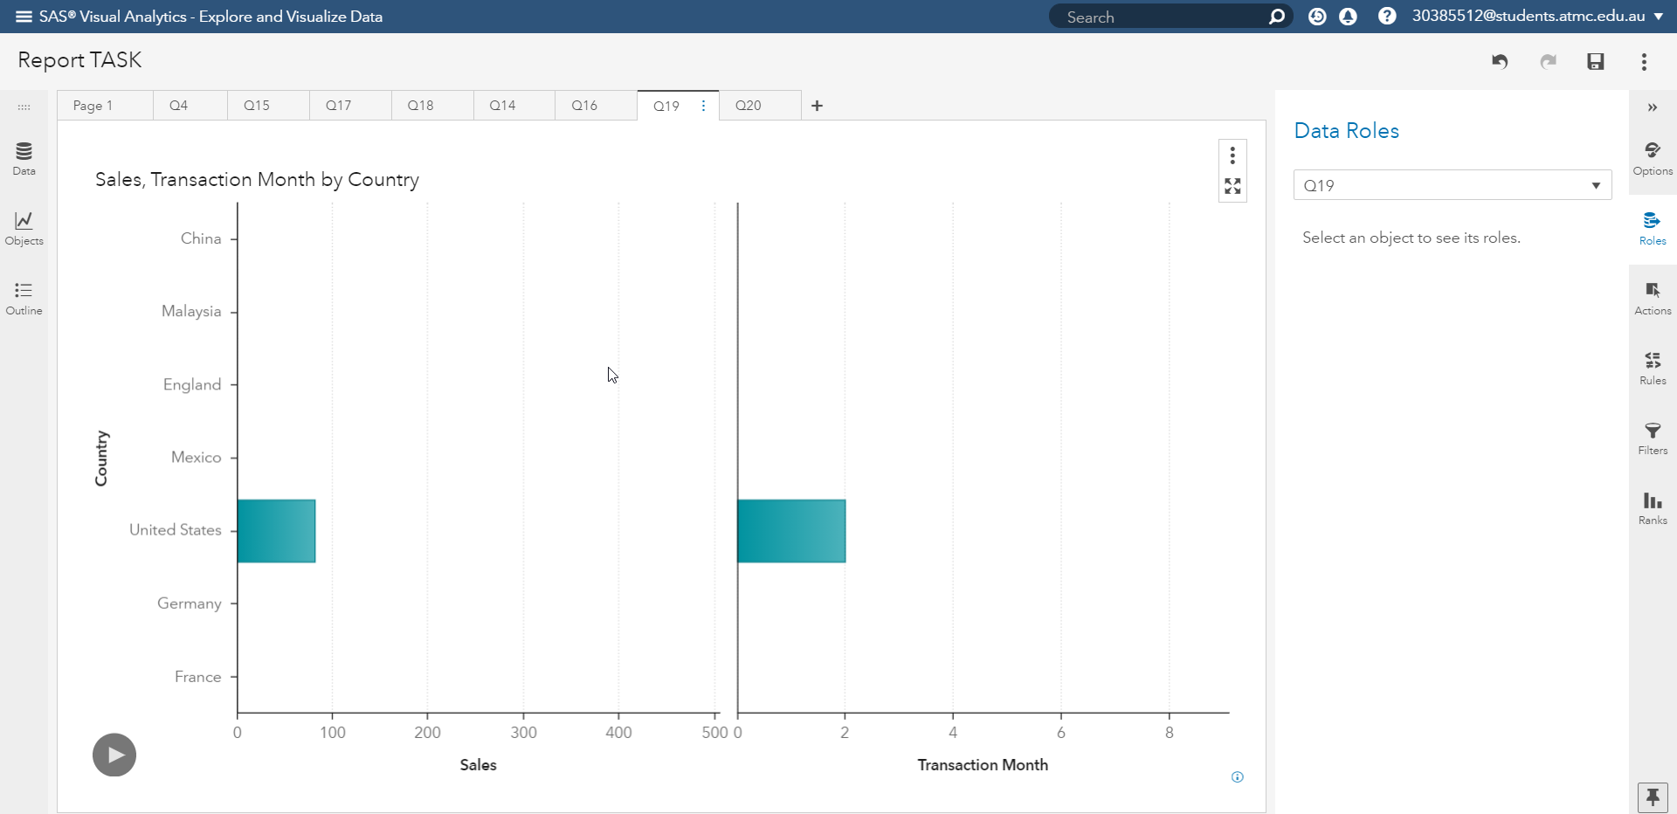
Insights
For the trend of sales from 01/01/2010 to02/01/2010 with respect to countries the animated plot is generated whose snapshot is depicted at the side.
the selected Country is United states.

Slide 8
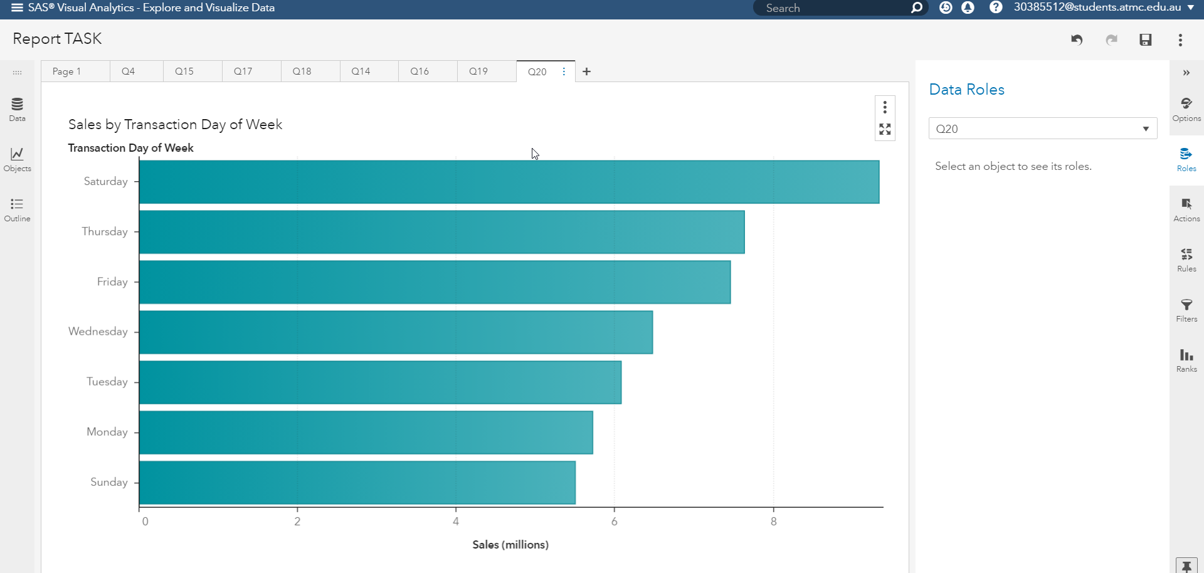
Insights
For the popular days of sale the plot at the side shows that the Sunday is least popular and Saturday is most popular day.

